Slide 1


Smart Transport
An application for tracking CO₂ emissons
and energy consumption regarding transport
Team 7
Prashanth B., Swe G. and Jonathan J.
Smart Energy – Fall 2017 – ETH Zurich

Slide 2
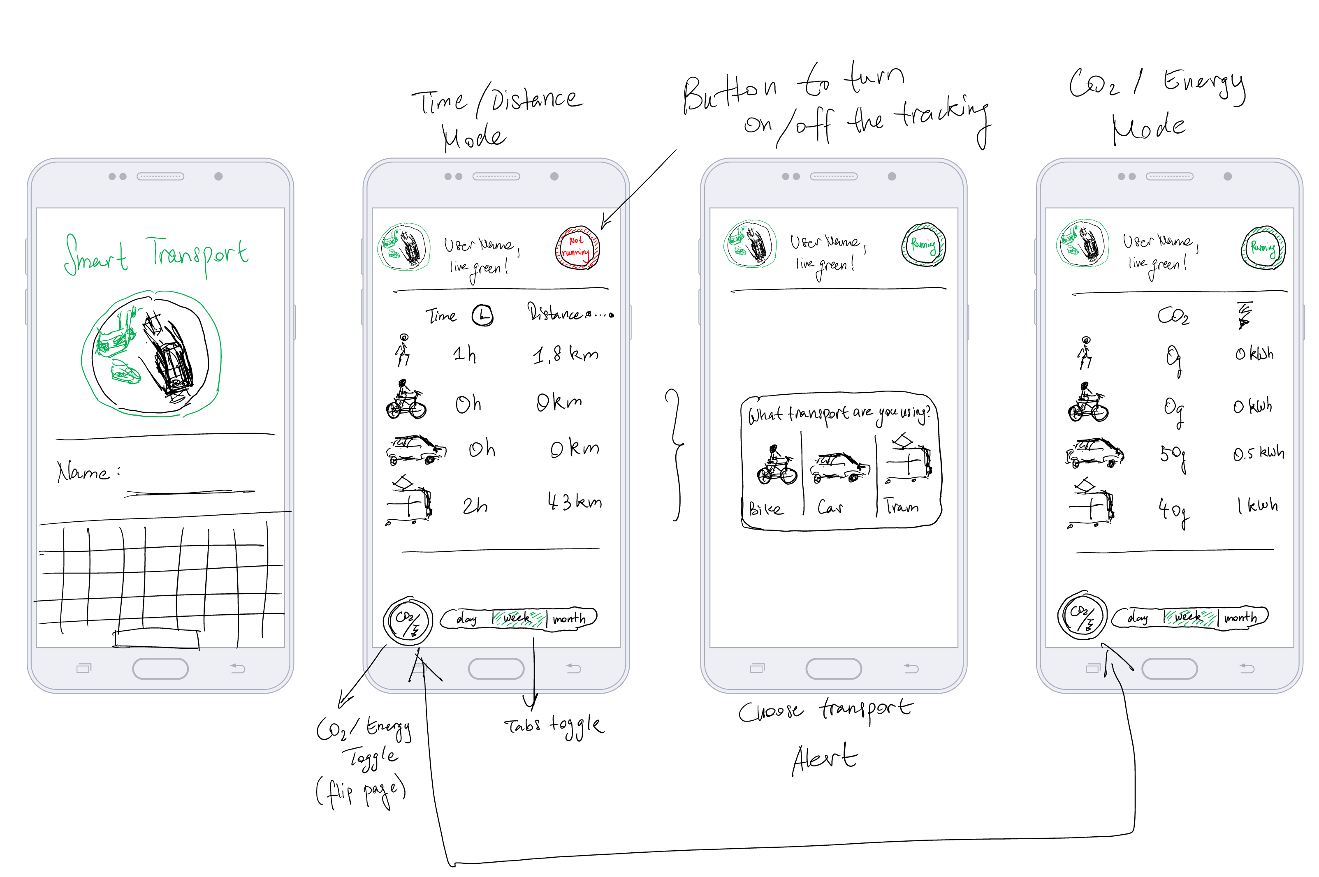
Mock-Up

Slide 3
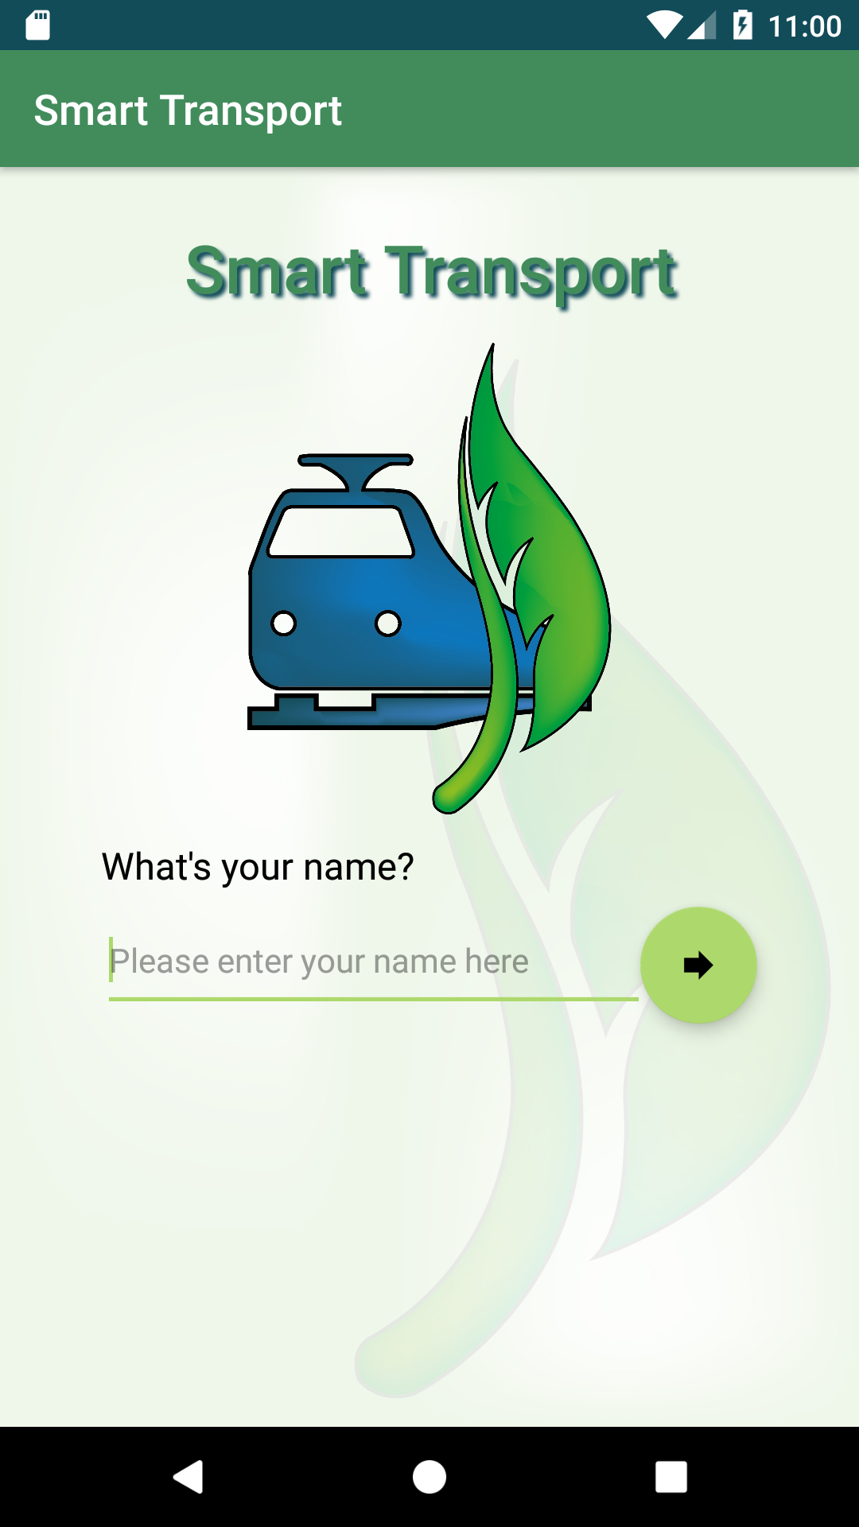
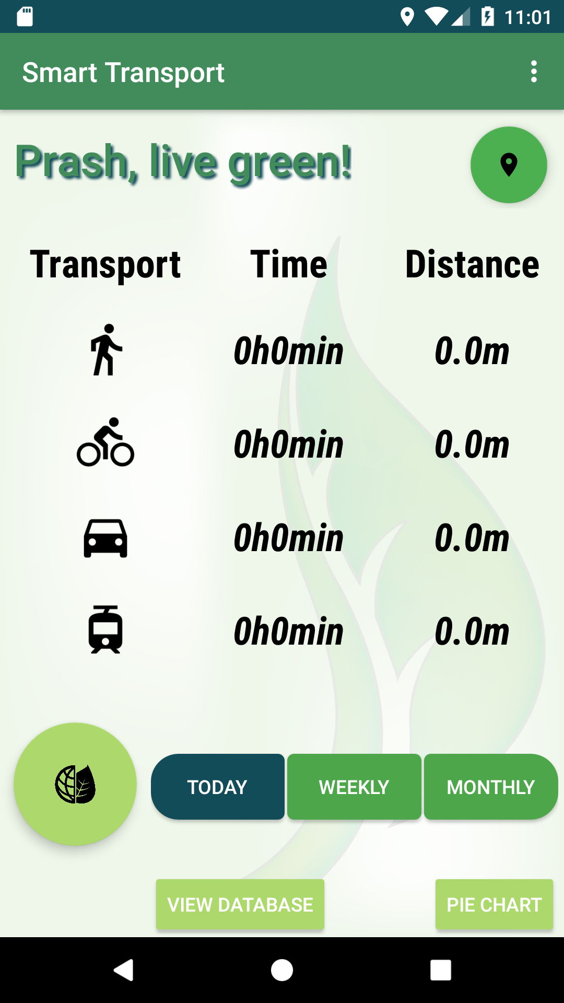
Graphical User Interface
Login Activity
Main Activity

Slide 4
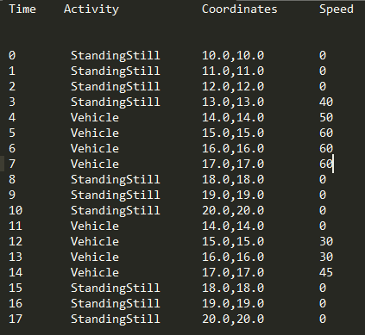
Automatically Infer Means of Transport
Detected Activity
Walking/Running/Standing Still
Bicycle
Vehicle
Tram
If(patternObserved && currentSpeedOverlap)
Car
Notes:
Parameters for inferring means of transport
Analysing patterns in traffic
Concluding typical movement patterns for the respective means of transports.

Slide 5

Calculate CO2 Emissions and Primary Energy Usage
As accurate as possible for Switzerland with
Primary energy vs final energy

Slide 6
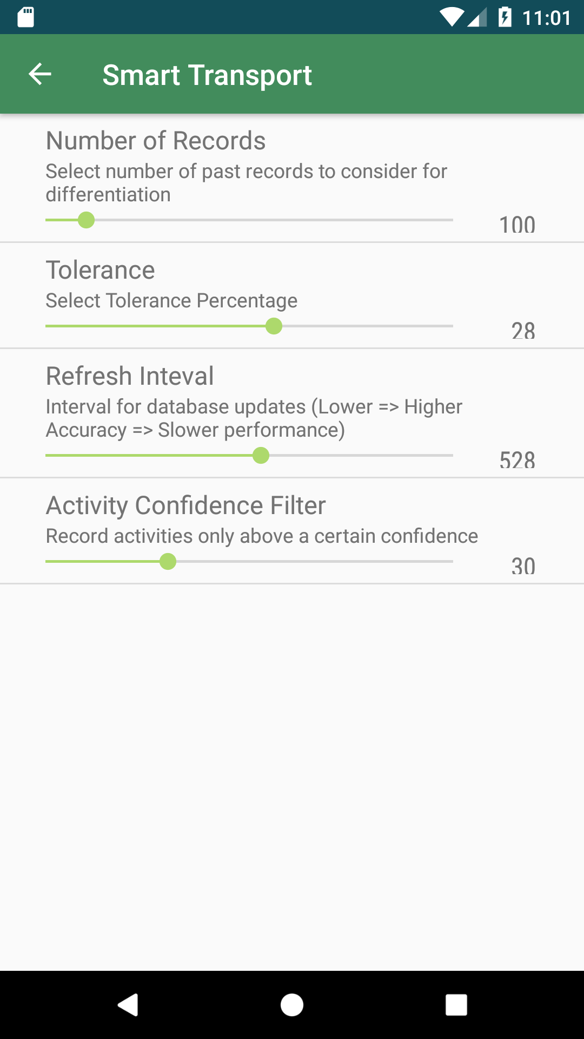
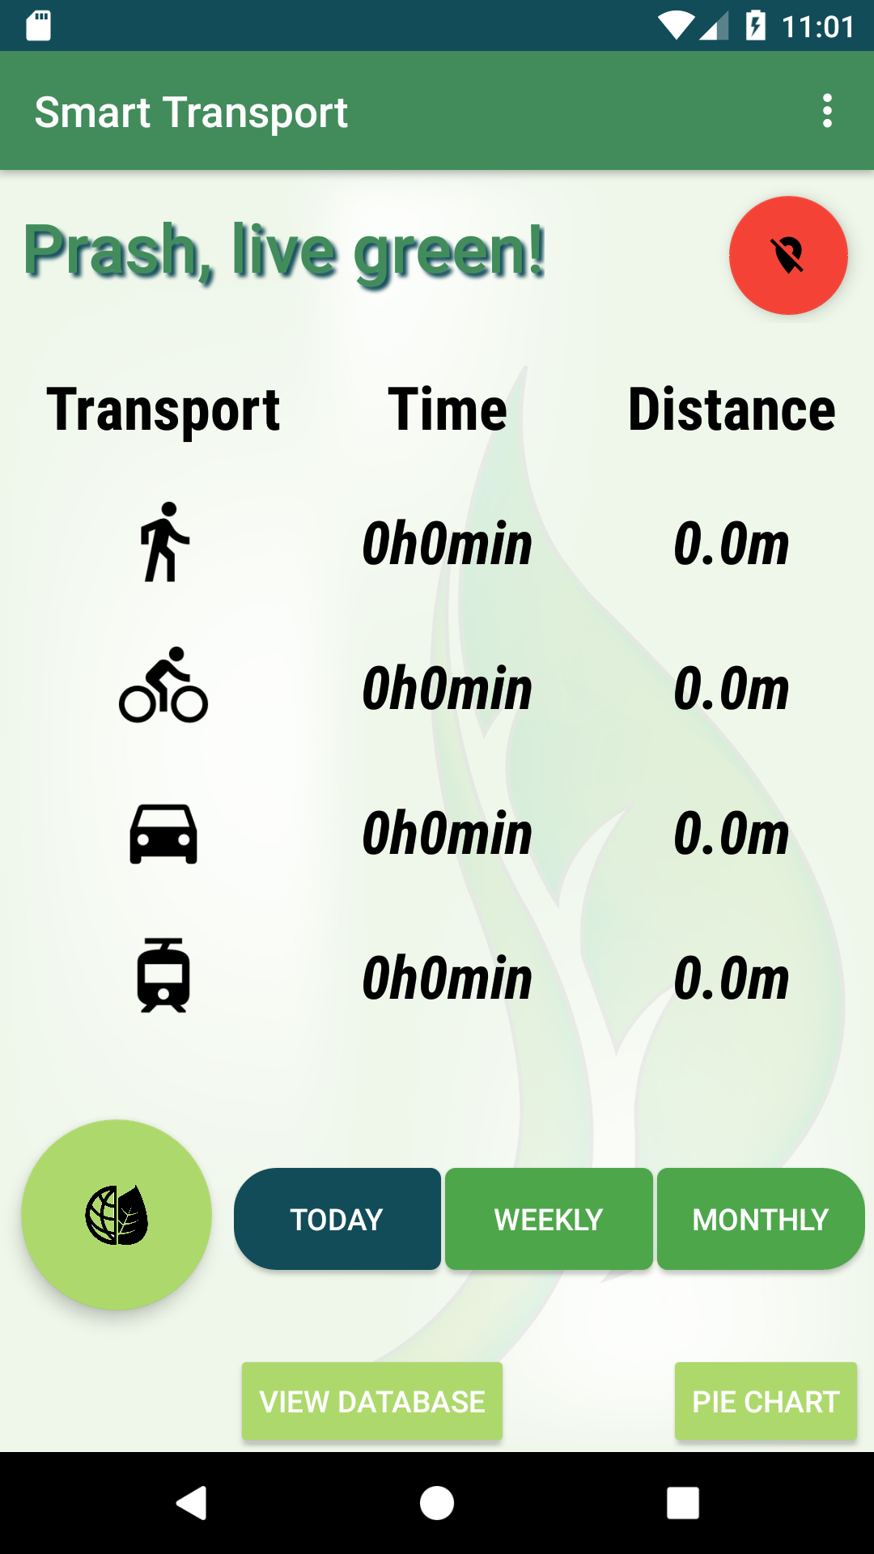
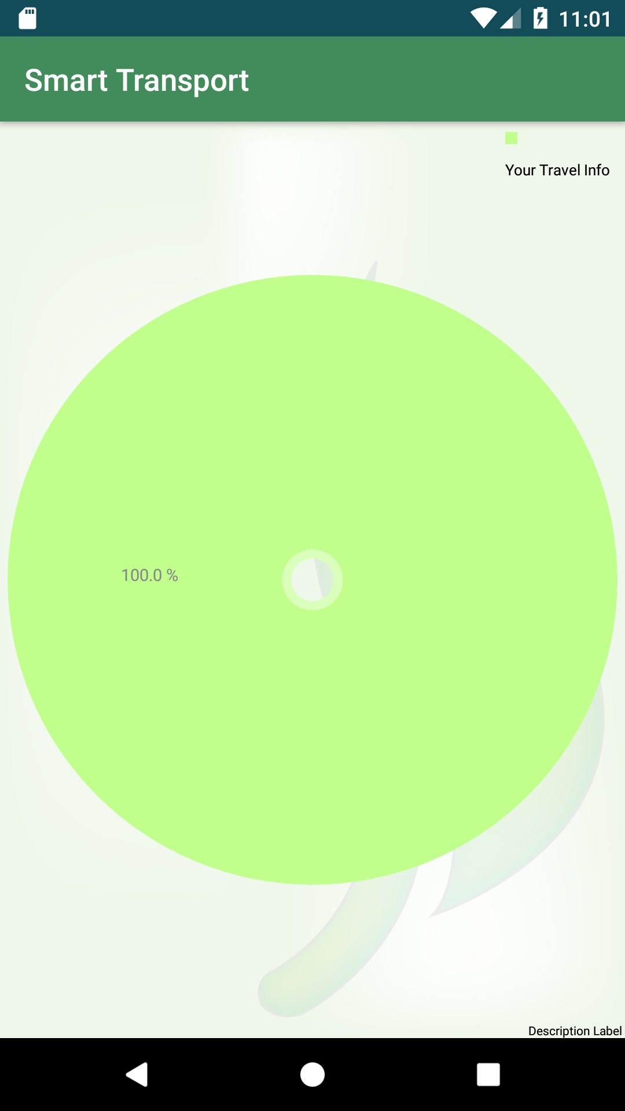
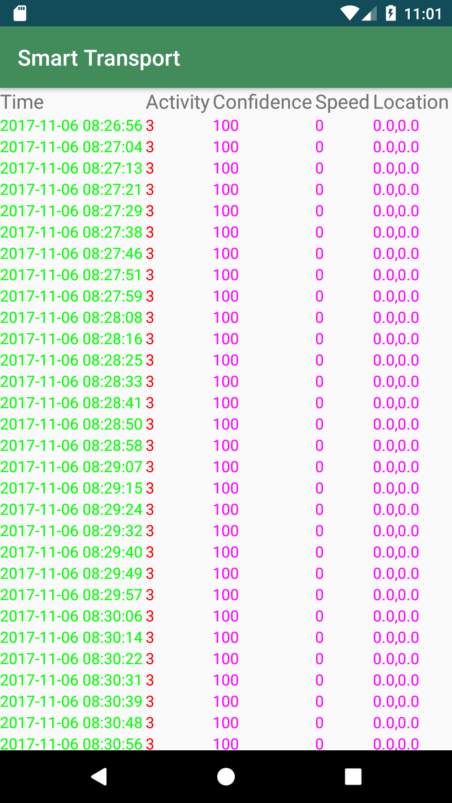
Architecture
UI Thread
Background Thread

Slide 7
Summary
+ Created an application that monitors day to day activities efficiently
+ Tackled the problem of car/tram differentiation
+ Flexible UI to enable/disable logging. Settings screen to fine tune parameters.
+ Appealing GUI with a Pie Chart!
Frequent logging leads to performance loss
Database queries pose a significant overhead with large number of records (>1000)
The code will be made open source for further development.
Lots of potential for more attractive features!

Slide 8

Live Green with Smart Transport!

